Slide 1
Beauty Salon Project
Author: Lina Chentsova
Trainer: Maxim Liashenko

Slide 2
Variant 17
Beauty Salon Schedule System. Create a page that displays the schedule of the salon employees, so that you can make an appointment. Only Administrator and Master should see customer Appointments, others only see the occupied space. After the providing of services, the Client leaves a comment. Suggestion for writing a comment arrives by Email. The Administrator can read comments.

Slide 3
General project requirements
Build a web application that supports the following functionality:
1. Based on the entities of the subject area, create classes describing them.
2. Classes and methods should have names reflecting their functionality and should be competently structured by packages
3. Information about the subject area should be stored in the database, for access use the JDBC API using a connection pool, standard or developed independently. MySQL is recommended as a DBMS.
4. The application should support work with the Cyrillic alphabet (be multilingual), including when storing information in the database.
5. The code must be documented.
6. The application should be covered by unit tests.
7. When developing business logic, use sessions and filters, and process events in the system using Log4j.
8. The application must implement Pagination, Transaction, depending on your project
9. Using servlets and JSP, implement the functionality proposed in the formulation of a specific problem.
10 . Use JSTL library in JSP pages
11 . The application must correctly respond to errors and exceptions of various kinds (The user should never see stack-trace on the front-end side).
12 . The application must implement the Authorization and Authentication system

Slide 4
Used technologies (Spring Project)
 | Spring project | Servlet project
Core | Java 8, Maven, Spring Boot | Java 8, Maven, Servlets on Tomcat
Model | Hibernate, JPA, MySQL | JDBC, MySQL
View | Thymeleaf | JSP + JSTL
Controller | Spring Security
Logging | SLF4J | Log4J
Tests | Junit | Junit
Additional | BCrypt, Lombok | BCrypt

Slide 5
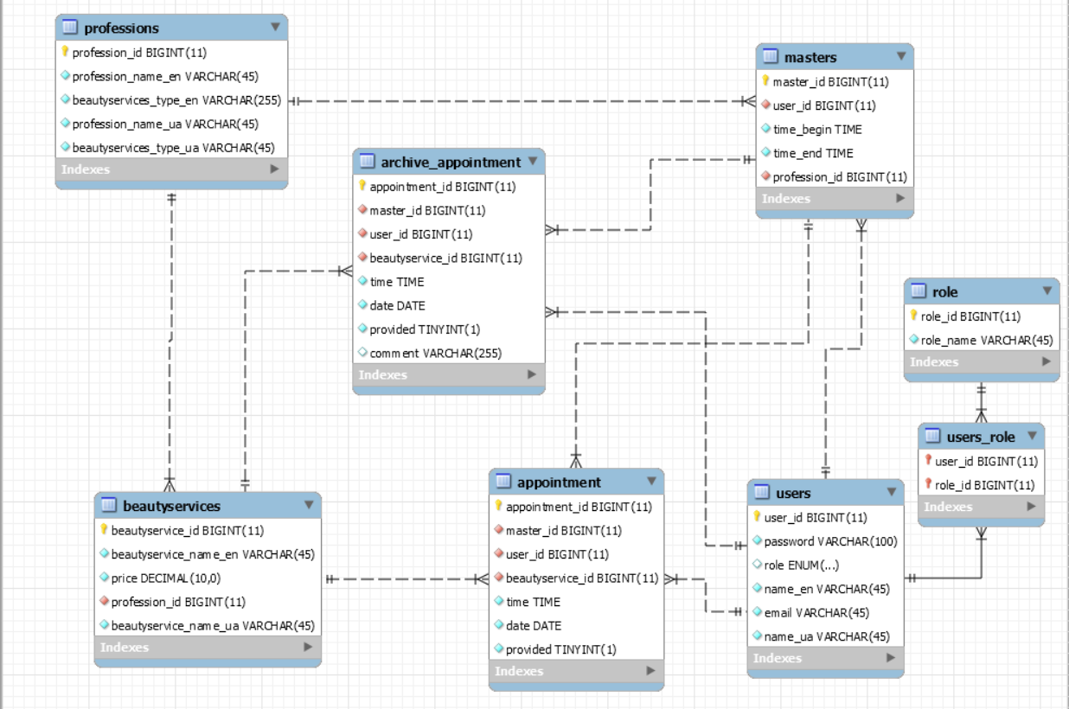
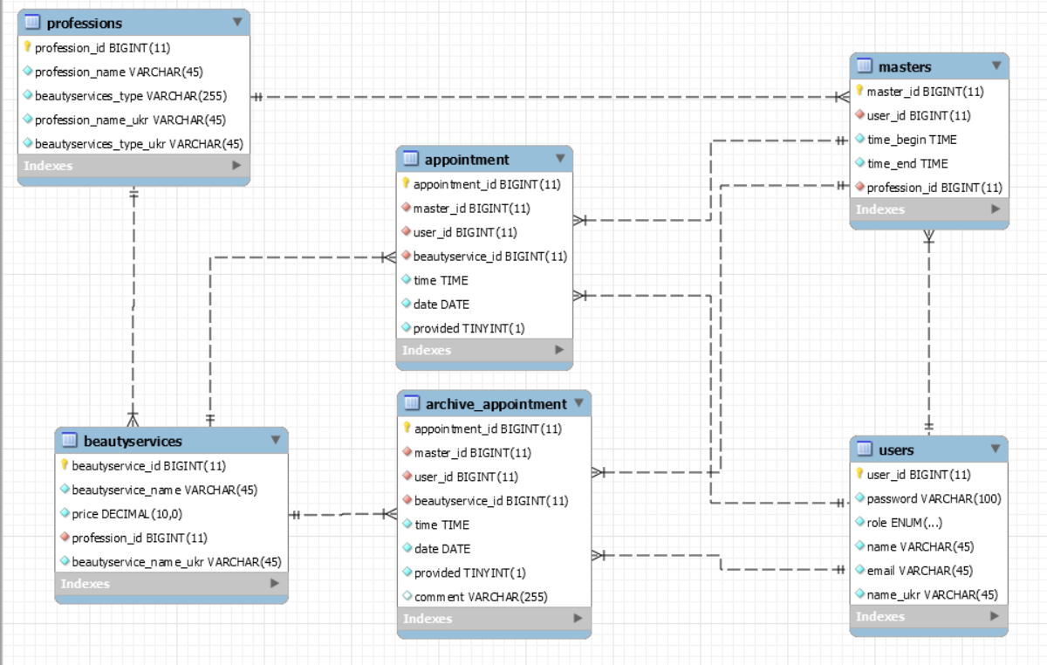
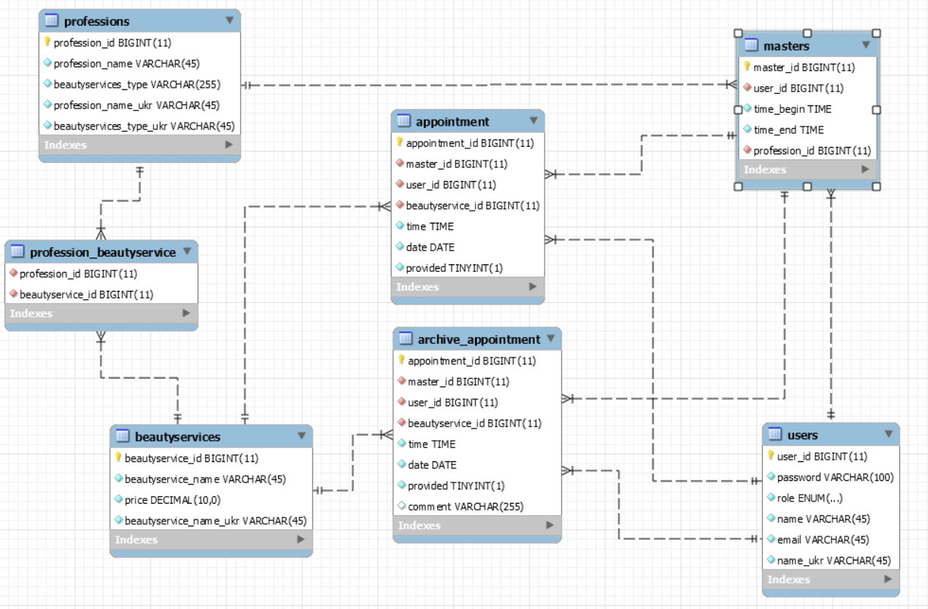
Database EER

